Slide 1
VZConnect Update
July 8, 2021

Slide 2
Daily Agenda
3G Migration
Migration Progress (Augustine)
Action Log Update (Augustine)
Data Clean Up Update (Nicole, Ricky, Nishant & Anil)
Issue Review (Nicole)
Incremental Enhancements (Augustine)
Top 10 (Christy)
VzC Overall IRs (Sweta)
Note: Billing Issue included in IRs & Top 10

Slide 3
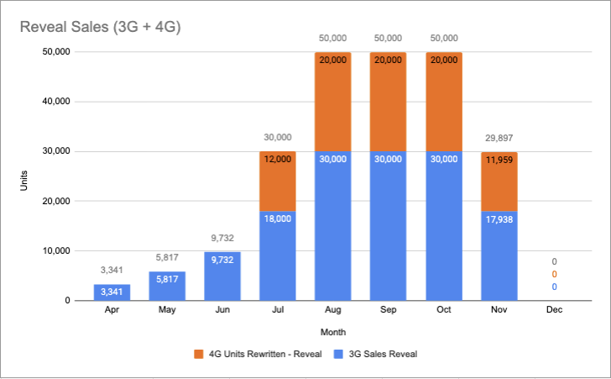
3G to 4G Migration | Migration Glidepath & Progress
Note: Kanetha to add daily actuals
Key Decisions or Progress
Follow up sent to Jennifer (Business) on 7/9 for the list of customers who received campaigns.
Actions targeted to accelerate Reveal migrations

Slide 4
3G to 4G Migration | Action Log Update
Key Decisions or Progress
6 open are the Data Clean Up activities, subsequent slide provides detail and ownership.
New Request today for Report of Accounts with PO with 2 VTUs Tech ref ids.
EA task for data flow, target TBD.
Top Issue: Vendor access for ESN Cleanup
Status | Business | GTS | Grand Total
Completed | 1 | 8 | 9
In Progress | 6 | 4 | 10
Grand Total | 7 | 12 | 19
Detailed Log
https://docs.google.com/spreadsheets/d/1limCNKRGXVSkIRDZg1r98w78lzZpfJsRRrRYo_JNkhw/edit#gid=100399731

Slide 5
3G to 4G Migration | Data Migration Issues & Progress
Total Devices - AT&T, VZ & Mixed Fleet
Accounts 61K | ESN 1.3M
ESN Status Mismatch
Accounts 21k | ESN 280k
Multiple buckets for cleanup
ESN Qty Mismatch
Accounts 20K
RPA BOT to update qty
ESN in Reveal not in 1ERP
Accounts 29.6K | ESNs 330K
Need Business Alignment
Billing Impacts - Increase in Bill
ESN in 1ERP not in Reveal Accounts 29K | ESNs 239K
Need Business Alignment
Billing Impacts - Revenue loss
Anil gathering volume for decision on path forward.
Anil gathering volume for decision on path forward.
1ERP-Shipped
Accounts 18K | ESNs 84K
Automate scripts to resolve status mismatch in 1ERP
1ERP- Active
Accounts 2.8K| 26K ESNs
Automatic scripts to update status in 1ERP
Pending business sign-off
Reveal - Active & 1ERP-Deactivated
Accounts 711 | ESNs 2.5K
Need Business Alignment
Billing Impacts - Revenue loss
Ricky working with business to sign off by 7/11
Chris Whitman requested no action
Chris Whitman requested no action
Business Process for Manual Data Fix:: https://docs.google.com/presentation/d/17ESTVCr5Rvi_uRE0tJGJ4t1ySOPgAB_K9IIlpEtprsg/edit#slide=id.p
Notes:
280k in total for AT&T devices (ESN)
1st Sale for 10 and Reveal has 10 ESNs..
7000 AT&T accounts (not 8000 any more) -> ~140k ESNs within these accounts
-> Reveal & ERP Qty match.. (3500)
-> Expected to be handled by the BOT
-> 5-7mins/account
-> Account with more ESNs in Reveal than ERP
-> Customer will start billing if they are added to ERP
-> Need customer engagement to confirm if they are fine with billing
-> Account with more ESNs in ERP than Reveal
-> Make a business decision to remove them from ERP as they are being billed but not being used in Reveal.. Customer engagement can be eliminated...

Slide 6

3G to 4G Migration | Matching Quantity Update
POC: Melissa Parry & Hindira (GTS)
Data Targeting: Qty match but ESNs associated with are not aligned with that total.
Query Details
Compare
Total ESNs in S4 to ESNs in SL to ESNs in Reveal
Order Line Qty & ESN Qty Match
If equal, then check if order line items to see if any have a tech ref id not expired and with no esn attached.
if so, then will upload list in S4
Append ESN into S4
Check for duplicates and only insert the missing (7/9 addition)
Reveal is what customer will see so is the golden list.
Assumptions
Reveal does not have a TechRef ID
Restricted to a single Tech Ref ID (aka Order) (SL Data) < 7/9 Addition >
Quantity is a mutually exclusive field, is not calculated, so BOT may be needed to retain going forward.
BOT uses SF b/c it is mirroring the user.
S4
SF
SL
Reveal
7/9 Action:
Ricky team (Vansi) validating methodology and if this can be done once via script.
Discussion needed on
plan to update SL
How to handle multiple orders/techrefids
BOT Diagram: https://docs.google.com/document/d/1tCYfX8JBiwedPqC7Gbsv1i1oE0uf7kRq/edit#heading=h.1ksv4uv

Slide 7
VzConnect | Mis-Matching Quantity
POC: Melissa Parry (Biz) & Nicole (GTS)
More in Reveal then ERP
Scenario: 10 in Reveal but 5 in ERP (billed for)
Opportunity (once get #s we can get approvals)
If not reported in over a year, we can remove it.
If more than a year, we need to call the customer to determine if add to bill or cxl
Query: Total >365 and <365
Qty in Reveal <> ERP
Last Reported Date in Reveal is last time the device was pinged
More ERP than Reveal
Scenario: 10 in ERP & 5 in Reveal.
The 5 in Reveal are part of the ones in ERP
The 5 in Reveal are different (one or many) than the ones in ERP
Opportunity: If the 5 are the same, then we remove the extra from ERP
Query: Output the list of ESN & Customer Account
List of ESNs which have More in ERP than Reveal where the overlap is the same ESN
List of ESNs which have More in ERP than Reveal where the overlap is not the same ESN
7/9 Action: Anil working with team today to get data request. ETR to be provided after discussion.
Once data provided Nicole will work with business to determine path forward.

Slide 8
Top 10 Projects
Not Applicable | ∎ | Not Started | ∎ | Jeopardy | ∎ | At Risk | ∎ | On Track | ∎ | Complete | ∎
Initiative | Short Description | Lever | GTS Delivery Status | Target Launch | Key Comments
3G Upgrade Program - Phase 3 | Upgrading devices from 3G to 4G on the existing customer accounts. | VZC (Product: Commercial R&D) | ∎ | 07/22 | Aligned to #1 Billing Issue
Renewal Relevancy Project | The Upsell features should absorb the renewal relevancy of the parent product (VTU). | VZC (Sales/Sales Ops) | ∎ | 08/19 | Aligned to #5 Billing Issue
Commercial Cancellation and Buyout Automation | Automation to occur between SFDC and ERP systems for both Full Platform and Partial Cancellation opportunities. | VZC (Product: Commercial R&D) | ∎ | 08/19 | Aligned to #8 Billing Issue
Reveal for VZC GSA + Billing Triggers | Operationalize systems, processes, pricing/contracts to enable government customers to purchase Reveal under a Verizon Connect dedicated GSA contracts | VZC (Product: Commercial R&D) | ∎ | 07/22 | Aligned to #7 Billing Issue
Billing Trigger Default Update | Adjust the default billing trigger to 30 days or bill as install. | VZC (Accounting) | ∎ | 08/19 | Aligned to #7 Billing Issue
VZC Upsell features co-term to the VTU | Design all Upsell features (e.g. Video, Reveal Field etc) have a term but need to co-term with the VTU. | VZC (Product: Commercial R&D) | ∎ | TBD | Aligned to #5 Billing Issue
VZC - VDD Expansion Program 2021 | Replace 3rd party devices & peripherals, give customers the ability to complete self install and support 3G program. | VZC (Product: Commercial R&D) | ∎ | TBD
VZC Reveal in Stores 2021 Program : Reveal Starter 1.5 Affiliate Agreement | Affiliate agreement between VZC & VZW. Scope is to create a workflow so that VZC can invoice VZW and in turn, VZW will be able to pay VZC through this flow. | VZC (Product: Commercial R&D) | ∎ | TBD
4698 - Verizon Connect Customer Portal | Project request is focused around creating a portal for our customers to access features and functions that are currently available to most product lines today | VZC (Global Customer Success) | ∎ | 08/19
Reveal for Government - VZW SLED & Sourcewell | Enable the Government channel in the United States only for VZW -) Contracts (SLED Government and Nonprofit entities) and Sourcewell. | VZC (Sales/Sales Ops) | ∎ | 07/22

Slide 9
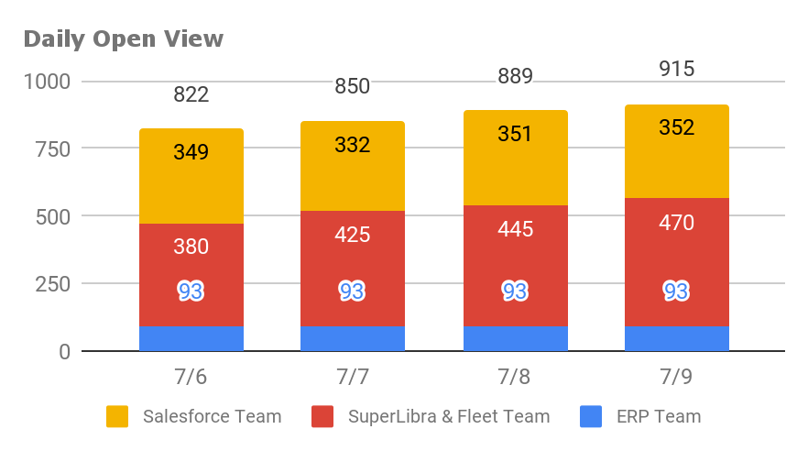
Verizon Connect | Incident Summary All VzC (7/9)
Highlights
Salesforce glide path added
Working with ERP & SL to build out glide path next week.
Necessary clearance update in review and actions to be provided 7/11.
TechHub scheduled to retire 3Q

Slide 10
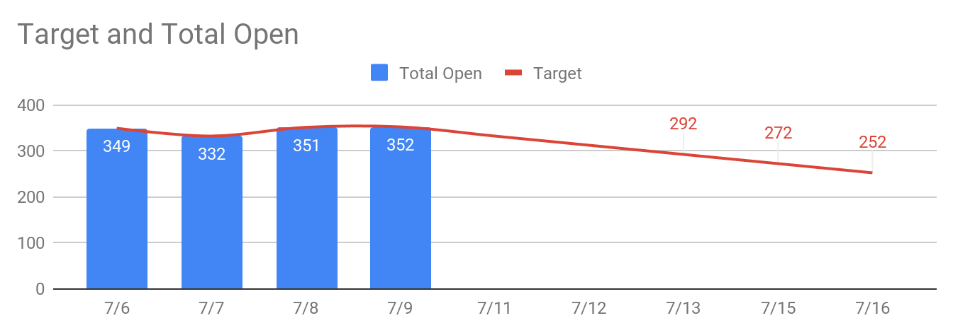
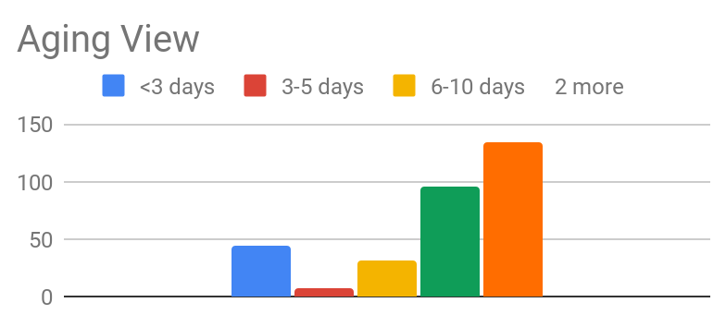
Verizon Connect | Incident Summary SF (7/9)
Pending aging history.
351
56
181
114
Total Incidents
In Progress
On Hold
Resolved
Highlights
73 with Response Pending to be closed or reopened by 7/16
136 with Response Received being analyzed to close or reopen. 30% per week with assumption that 20% will reopen during reviews.
Offshore driving clean up of queues and to start picking up IRs in coming week.
Goal: Close 20 per Day
‹#›
Notes:
Fleet Application-

Slide 11
VzConnect 3G Migration | Detail
Issues Resolved | Defects Open
22 | 13
 | Open 3G Incidents/Defects
Incident # | Issue Description | Open | ETA | Owner | Impact | Status
INC0120186 | Renewal Language not populating in Expansion section when Expansion present | 4/21 | 7/6 | Dan Bergondy | SFDC | Ready for UAT - Quan L. .
INC0120323 | Contracts not populating any product information | 4/22 | 6/30 | Abigail Templin | SFDC | Ready for business retest - Quan L
INC0127563 | Rewrite full consolidation showing as partial - all active POs pulling into quote | 6/22 | 7/6 | Carla Johnson | SFDC | On Hold, no active pending orders
INC0123107 / 22483 | Completed Rewrites not flowing to ERP | 5/13 | TBD | Andy Sidwell | SL | Clean up of May ‘20 Failed order.s. Proposed LT goal - reviewed & tested by EOW 7/16
INC0127668 | ESN Mismatches - 30K ESN Mismatches identified in the system | 6/23 | 7/8 |  | SFDC/ERP | Pending action, 5 accounts
 | 79K line items needing to be marked as installed via SL script. | 6/24 | 7/8 | Jeff R | SL | Still analysis, discussing technical approach
INC0128034 | SVT allowed to Sale Confirm a backdated Rewrite. This should be blocked by the system | 6/24 | 7/12 | Gabriel Olagoroye | SFDC | Prod Change - Move on 7/12
INC0127305 | Short Term: One PO with two TechRefID, when doing a rewrite it does not pull all of the ESNs. | 6/21 | TBD | Carl West | SFDC/ERP | Clean up in progress LT: VBGTNA-58
INC0128479 | Incorrect Values being pushed downstream impacting customer billing preference for BuSS ~950 account impacted | 6/29 | TBD | Carl West and Andrew Wilson | SFDC/ERP | New AYS tioket opened INC005932515
INC0126811 | Impacting Peak Utility | 6/30 | 7/12 | Andrew Wilson | SFDC | Prod Change - Move on 7/12
INC0129161 | Trying to upgrade ESN 53534479 but when we check that ESN and hit upgrade, nothing happens. | 07/06 | TBD |  | SFDC | In Analysis
INC005927246 | Account have POs with both inactive and active units. Need to know how to proceed. | 07/06 | TBD |  | SFDC/ERP | On Hold - Pending Decision for system limitations
INC0129310 | 3G to 4G Migration - these POs are pulling in, but after hitting amend the units are not showing in CPQ | 07/07 | TBD | Dan Bergondy & Carl west | SFDC/ERP | In Analysis
Tracker: https://docs.google.com/spreadsheets/d/1pGQ2gQy0mPoxDvJWcEDsrPfRZ2-KQMbuuqbd1s_1zzo/edit?ts=607dfa7f#gid=318007284

Slide 12
VzConnect 3G Migration | Detail
Enhancements Open | Enhancements Ready for Prod
13 | 2
3G Enhancements Details
Description |  | Priority | Status
Orders that were installed, not showing as Installed |  | 1 | In UAT
Add SOC Request Type: Install Status Update | VBGTNA-54 |  | Ready for System Testing
Select All PO# in Manage Order | VBGTNA-50 | 7 | Ready for System Testing
Asset Trackers are not available for the 3g functionality | VBGTNA-45 |  | Ready for Iteration
Renewals occurring without ESNs (non evergreen, or manual) | VBGTNA-48 | 5 | In Grooming
Contract effective date functionality and next bill date issues / System won't allow me to click 3G upgrade button in CPQ due to missing start date. Screenshot attached. | VBGTNA-46 | 2 | In Grooming
Customer Contract Billing language not matching the fixed start date treatment of the 3G Upgrade units | VBGTNA-52 | 6 | In Grooming
Unable to cancel future dated orders (renewals) Blocking order from going to ERP | VBGTNA-53 | 3 | In Grooming
3G ESN Selection Process | VBGTNA-49 | 4 | In Grooming
Install Status of Post-ERP Orders | VBGTNA-51 | 8 | In Grooming
One PO with two TechRef ID, when doing a rewrite it does not pull all of the ESNs. | VBGTNA-58 |  | In Grooming
Bulk ESN load tool in S4 (SAP) that is used to assign ESNs to Bill Plan | VBGTNA-47 |  | In Grooming
Service Case (Cancellations) | VBGTNA-56 |  | In Grooming

Slide 13
Appendix

Slide 14
Current Architecture
SaaS NON GTS Owned
Homegrown GTS Owned
SaaS GTS Owned
Domain | Reveal (Commercial) | Fleet (Telogis) | Network Fleet
Marketing Mgnt
Lead Mgmt
Sales Mgmt
Learn Mgmt
Knowledge Mgmt
Portals
IVR
IAM Layer
Catalog/Quote
Contract
Order & Fulfillment
Activation
Billing
Support
Eloqua
VzC SFDC / Highspot / PeopleImport / Demand Tools
NWF SFDC / PeopleImport / Demand Tools
VzC SFDC / LeanData / Traction Complete
NWF SFDC / Decisions on Demand
VzC SFDC / XANT / Ambition
NWF SFDC
Skilljar (LMS) , Learning Portal 2.0
Dozuki, Knowledge Base (Mindtouch), ZenDesk
NWF SFDC content tab
verizonconnect.com
reveal.fleetmatics.com
login.telogis.com
networkfleet.com/portal
ShoreTel
NICE InContact
8x8
Avaya
ShoreTel
OKTA (*not all vz connect applications are enabled with OKTA)
VzC SFDC CPQ
NWF SFDC / Callidus Cloud CPQ
Nintex Drawloop
Conga
Apttus
Nintex Drawloop
Docusign
Adobe sign
Docusign
Cloud4Service (SAP)
Tigra
Wanaka
EStoreV2
SuperLibra
Hound
Reveal / SuperLibra
Shipping Tool
Wanaka
Installle
Work
Tigra
NWF Platform
EDAMP
VzCheck
Fleet
Fleet Hardware Installer
SAP BRIM / SAP S4
Legacy EMEA ERPs
Sage Intacct
Billing Service
PS 9.1
NWF Platform
Microsoft Dynamics GP
cForia
MBG
VzC SFDC / Gainsight
Telogis SFDC
TCMS / VEPS
NWF SFDC
SAP S4
SuperLibra
SMS DIAG
SMS DIAG
Wanaka
NWF Platform
RMT
GreenRabbit
FleetCare
Tech Hub (SNOW)

Slide 15



3G to 4G Migration Process Milestones
VZCheck
Eloqua
Salesforce
SuperLibra
1ERP
4
Submit Check In
Campaign to Targeted Customers
Customer expresses interest
Manage Order
2
Oppty
Quote
Contract
Submit Rewrite
(upsell and/or exp)
Close & Update
Rewrite line
with 3G upgrade
Order Status
Change
Shipment Processed
Installation Processed
Get Devices
Create Contract
3
Shipment 3PL
Shipped Status
5
1
Installed status/ Billing Invoicing
1
Get ESNs from active contract
Data Issue
3
Ship Device
5
Bill Customer
2
Initiate Rewrite with upsell and/or expansion
4
Vendor Professional Installation

